Slide 1
About LightUart_MultiPort
Features:
Change from LightUart;
Support showing the name by specifying;
Support multiport;
Support separating log-file;
Support named log-file by specifying configuration file;
Support named log-file by specifying the parameter “name”;
Support named log-file by default(entity name);
Support C++ style code;
Expand multi-terminal functions;
Example for using LightUart_MultiPort;

Slide 2
Change from LightUart
LightUart:
One port;
One log-file;
Log-file name can’t be changed;
LightUart
LightUart_MultiPort:
Multi ports;
Each port has two log-files;
Log-file name can be changed by naming;
LightUart_MultiPort

Slide 3
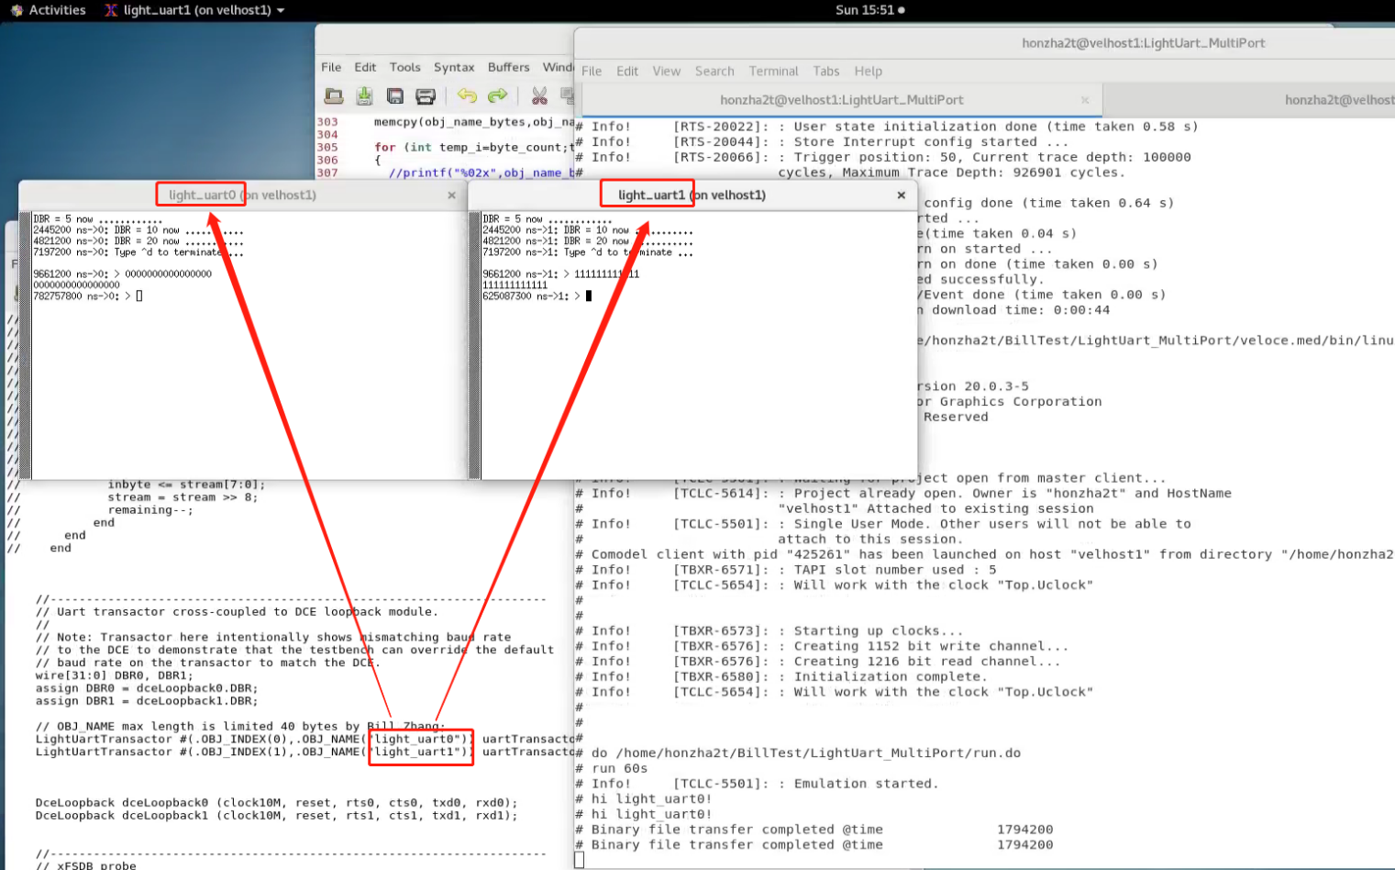
Show the name by specifying
You can specify showing name by:
Load configuration file;
Input parameter “OBJ_NAME”;
Default(no configuration, and OBJ_NAME is “”);

Slide 4
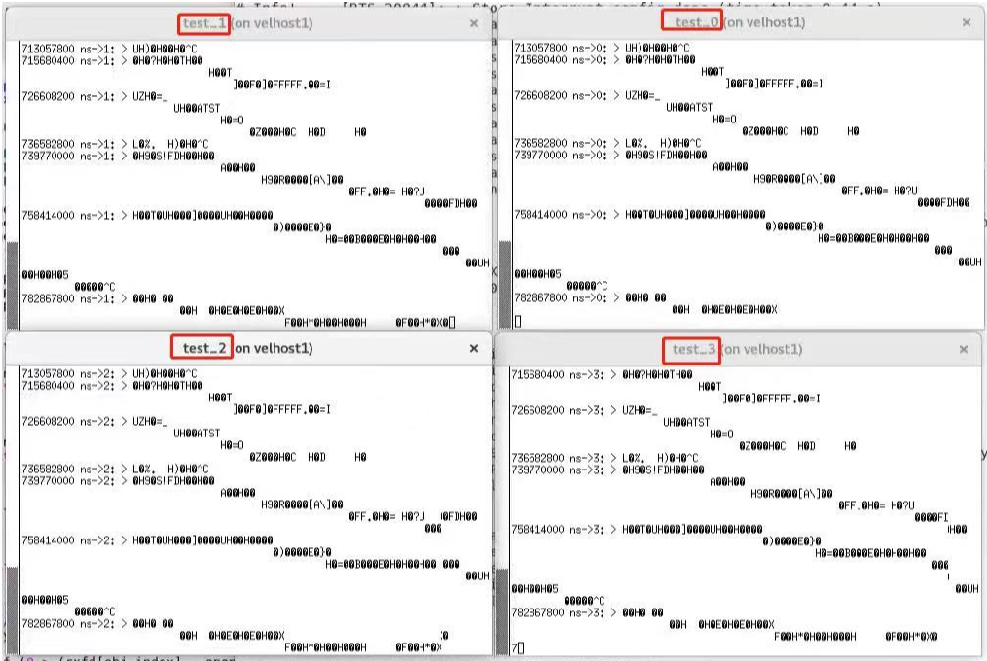
Multiport
LightUart_MultiPort support multi ports after you make multi entities;

Slide 5
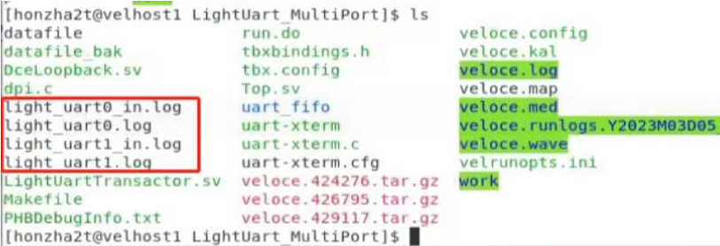
Separating log-file
LightUart_MultiPort will generate multi log-files after running and communicating with the DUT.

Slide 6
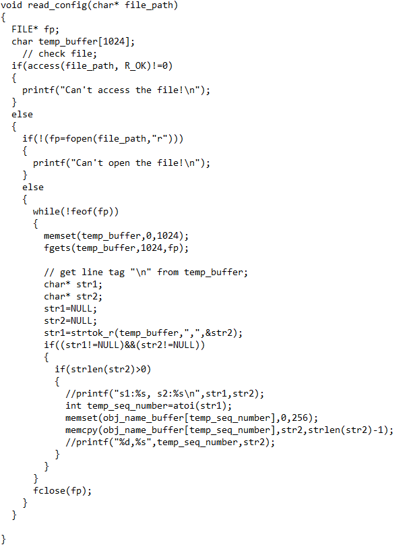
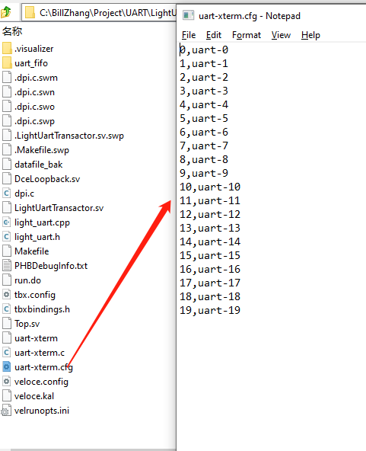
Named log-file by specifying configuration file
LightUart_MultiPort named log-file by specifying configuration file.

Slide 7
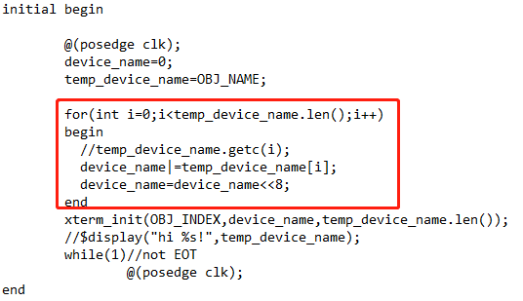
Named log-file by specifying the parameter “OBJ_NAME”
import "DPI-C" context function void xterm_init(int obj_index,input bit[399:0] obj_name,int byte_count);
LightUart_MultiPort named log-file by specifying the parameter “OBJ_NAME”.
LightUartTransactor #(.OBJ_INDEX(1),.OBJ_NAME("light_uart1")) uartTransactor1 (clock10M, cts1, rts1, rxd1, txd1 ,DBR1);

Slide 8
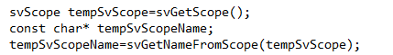
Named log-file by default(entity name)
LightUart_MultiPort named log-file by default(named by entity name):
Disable configuration file;
OBJ_NAME is empty;
LightUartTransactor #(.OBJ_INDEX(0),.OBJ_NAME("")) uartTransactor0 (clock10M, cts0, rts0, rxd0, txd0 ,DBR0);

Slide 9
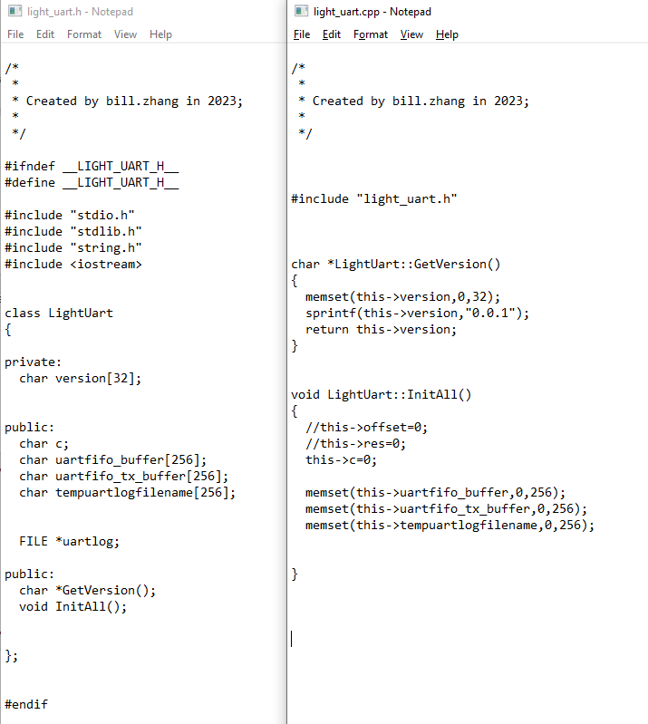
C++ style code
LightUart_MultiPort support C++ style code for OOP. It is more convenient for the programmer.

Slide 10
Instantiate entity
LightUart_MultiPort instantiate entity.
Note:
1. “OBJ_INDEX” must below “OBJ_NUMBER” that refer to dpi.c;
2. “OBJ_NAME” maybe empty (“”);
LightUartTransactor #(.OBJ_INDEX(0),.OBJ_NAME("")) uartTransactor0 (clock10M, cts0, rts0, rxd0, txd0 ,DBR0);
or
LightUartTransactor #(.OBJ_INDEX(1),.OBJ_NAME("light_uart1")) uartTransactor1 (clock10M, cts1, rts1, rxd1, txd1 ,DBR1);

Slide 11
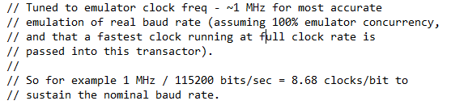
Set baudrate
LightUartTransactor #(.OBJ_INDEX(1),.OBJ_NAME("light_uart1")) uartTransactor1 (clock10M, cts1, rts1, rxd1, txd1 ,DBR1);
LightUart_MultiPort set baudrate.
DBR=(clock10M/baudrate)<<4

Slide 12
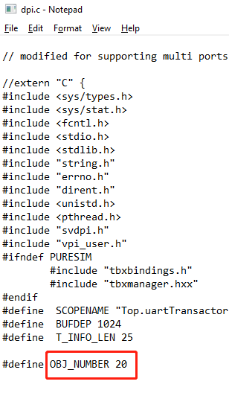
Specify Maximum supported ports
LightUart_MultiPort can be changed the maximum supported ports.

Slide 13
Expanded multi-terminal
LightUart_MultiPort Expanded functions
User connect Uart transactor directly by pipe;
Connect Uart transactor by terminal “xterm”;
Connect Uart transactor by TCP server;
Uart side
User side
User program connect to the Uart by Pipe
LightUart
Transactor
Pipe
xterm
key
User input
tcp server
tcp
User program

Slide 14
Expanded function setting
To use expanded functions:
0: User operate the pipe by program directly;
1: Connect to the Uart by “xterm” (default);
2: Connect to the Uart by TCP server;

Slide 15
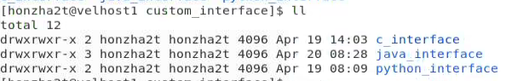
To use expanded functions
User operate Uart by pipe examples:
Support c/c++ demo program;
Support java demo program;
Support python demo program;
Support golang demo program;
…

Slide 16
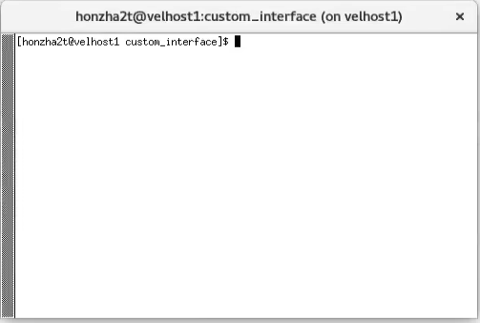
To use expanded functions
Connect to the Uart by “xterm” :
User just type character in the “xterm”;

Slide 17
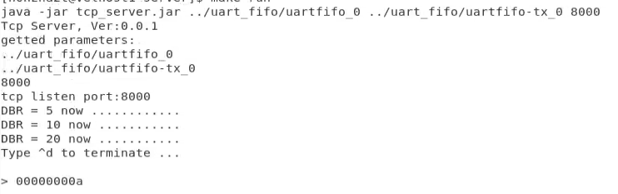
To use expanded functions
Connect to the Uart by TCP server:
User can use any language to connect to the Uart by TCP protocol

Slide 18
Example for using LightUart_MultiPort
HVL
HDL
TB(SC)
Veloce
HVL:
SystemC;
Startup a TCP server;
Dm_api;
TBX
DPI
SCE-MI
Third App
TCP
Python;
Java;
C/C++;
…
XRTL
TCP
TCP server
PIPE
DPI
LightUart
(java)

Slide 19
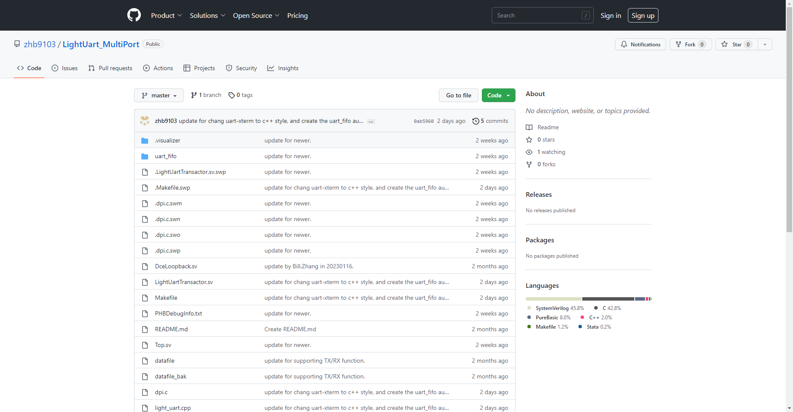
LightUart_MultiPort download
Download address:
https://github.com/zhb9103/LightUart_MultiPort

Slide 20
More function supports
To be continue…!

Slide 21
Disclaimer
OPTIONAL
© Siemens 2023
Subject to changes and errors. The information given in this document only contains general descriptions and/or performance features which may not always specifically reflect those described, or which may undergo modification in the course of further development of the products. The requested performance features are binding only when they are expressly agreed upon in the concluded contract.
All product designations may be trademarks or other rights of Siemens AG, its affiliated companies or other companies whose use by third parties for their own purposes could violate the rights of the respective owner.

